Slide 1
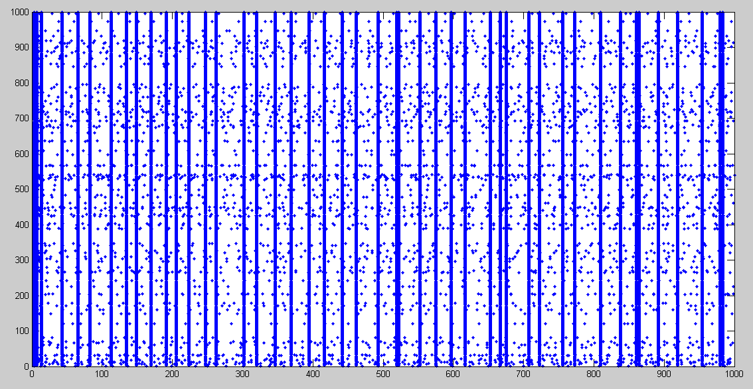

Slide 2
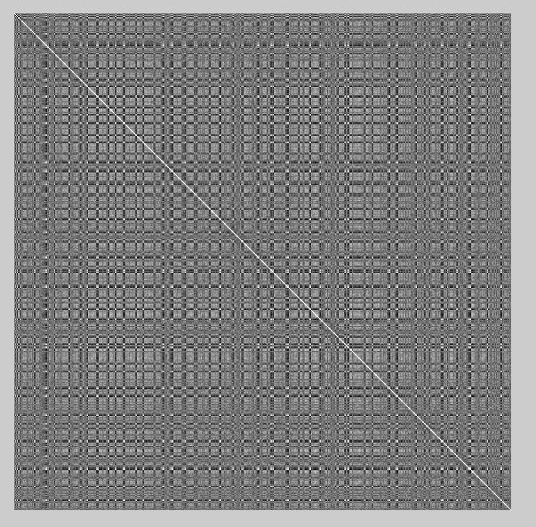

Slide 3
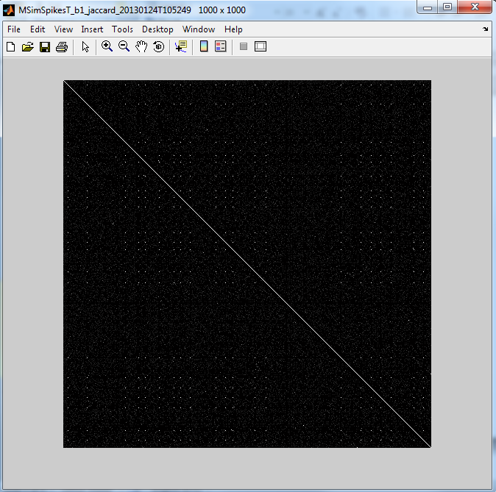

Slide 4


VV
Phase multivariate entropy of phase distribution
BUENA

Slide 5

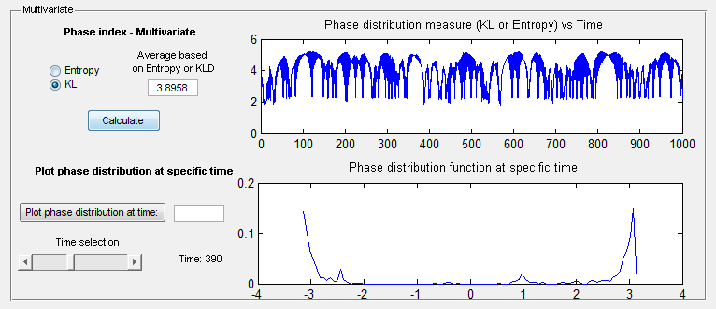
VV Transposed
Phase multivariate entropy of phase distribution
BUENA

Slide 6
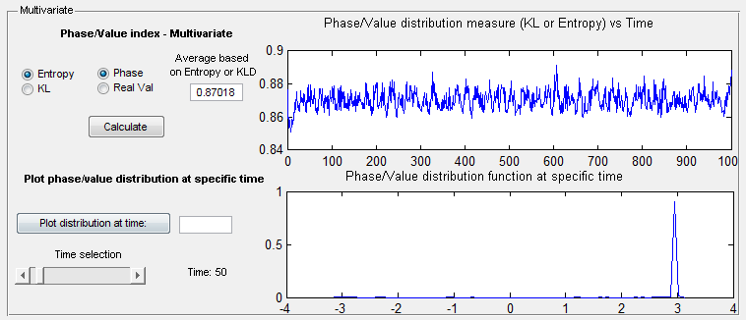
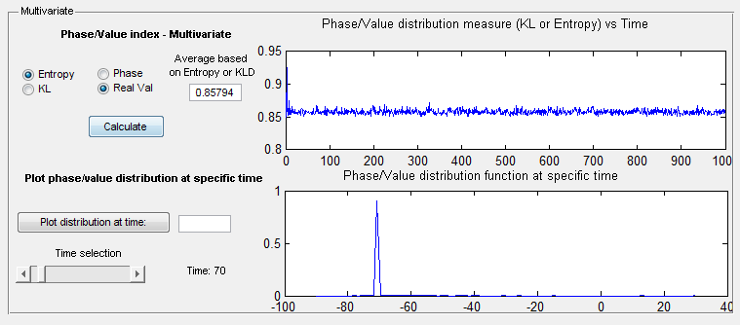
VV
Phase multivariate entropy of phase distribution

Slide 7
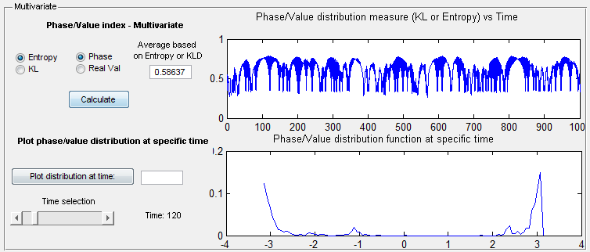
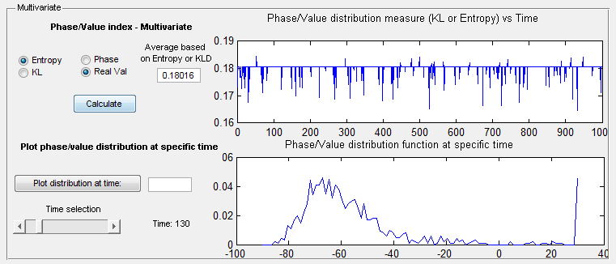
VV Transposed
Phase multivariate entropy of phase distribution

